Slide 1


TUTOR QUEST
Under the guidance of B. Pavan sir
Team Members:
19H51A05F6- D. Sai Teja
19H51A05F7- G. Sushma
19H51A05F8- G. Pranay Kumar

Slide 2

CONTENTS
INTRODUCTION
OBJECTIVE
ABSTRACT
REQUIREMENTS
PRINCIPLE OF OPERATION
RESULTS
ADVANTAGES/APPLICATIONS
FUTURE SCOPE
CONCLUSION

Slide 3
INTRODUCTION
Every person has right to study and every person who has knowledge can share their knowledge and teach people without any barriers. At present since the pandemic has shook the whole world, people lost their jobs, students were dropped out of schools and colleges due to financial crisis. There are platforms for students to find an online teacher and for an educator to teach. Many online platforms are providing 1:1 instructor class but are charging very high amount and has been turning into profitable organizations rather than building a bridge between such students and teachers.

Slide 4
AIM
OBJECTIVE
To build a platform for students and organizations to find teachers.
Our main objective is to build “TUTOR QUEST” web application.
Users are only teachers, students, organizations.
Proper verification of each is done to be able to signup.

Slide 5
ABSTRACT
Due to the pandemic many of the private teachers are losing their jobs. Parents also are facing difficulties as many online platforms are providing 1:1 instructor class but are charging very high amount. Our project’s aim is to connect such Teachers and Students where they can create account on our website and create profile which includes filling in their details. Students can browse through the list of teachers according to their requirement and contact them by their email-id/phone number provided in their description. It’s not limited to students as even organizations can find teachers if needed. Our project can be created using front-end and backend technologies. We used HTML, CSS for front-end and PHP, MySQL for backend. Through this website we can connect such teachers and students which is beneficial.

Slide 6

REQUIREMENTS
The requirements of our project are:
Personal Computer
XAMPP server
VS Code Editor

Slide 7
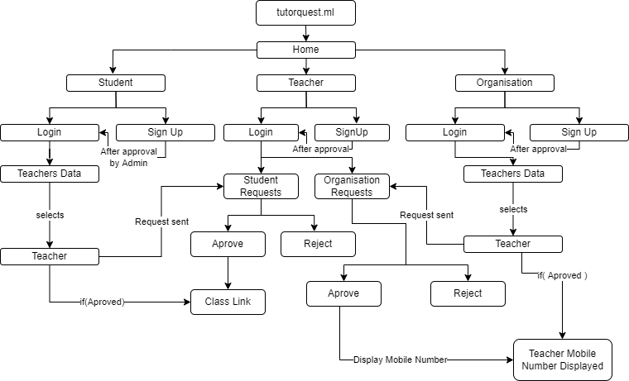
Flow Chart

Slide 8
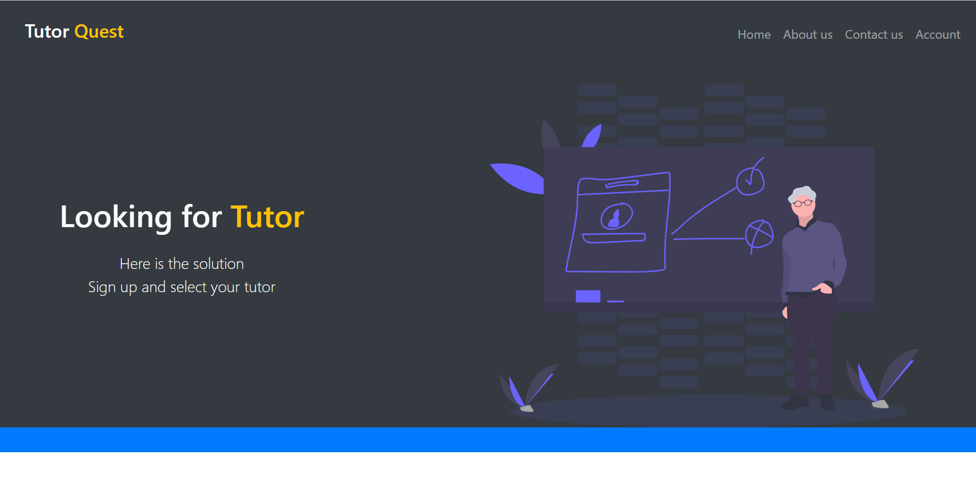
RESULTS (http://tutorquest.ml/)

Slide 9
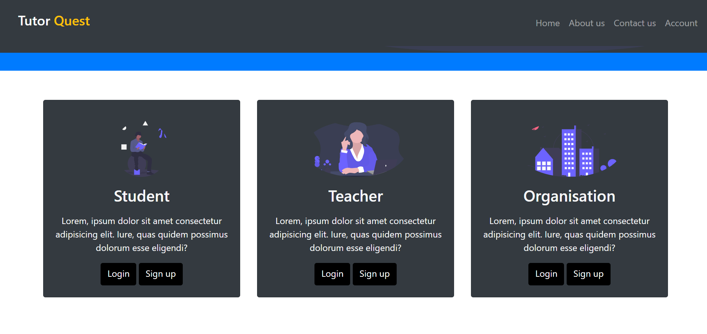

Slide 10
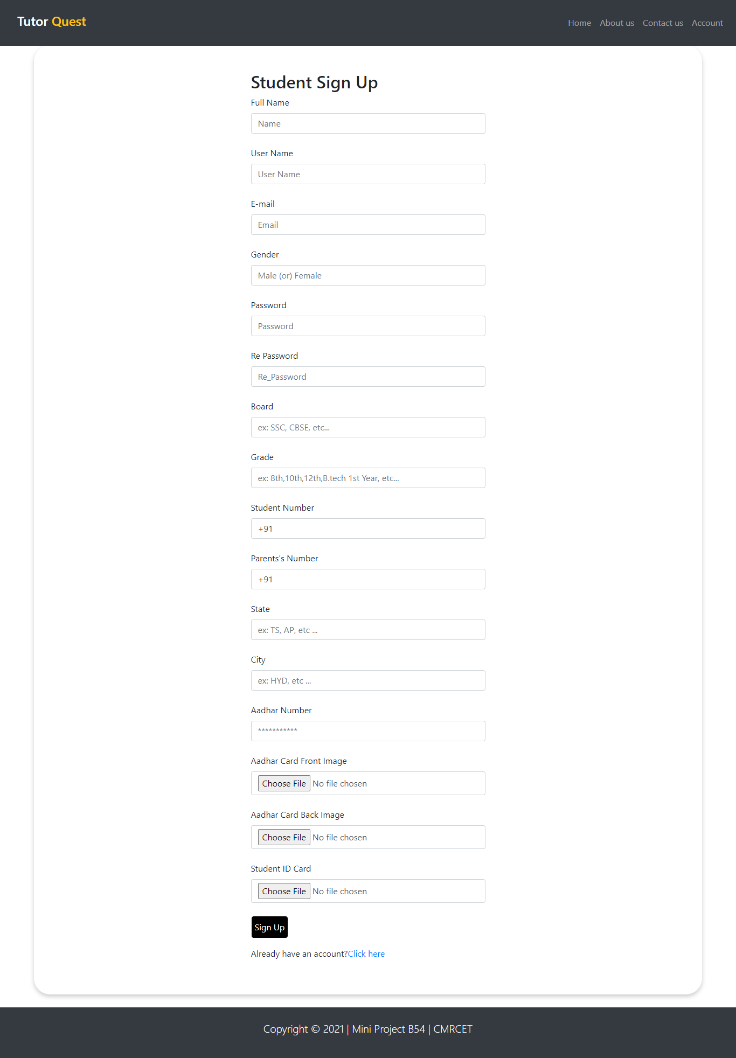
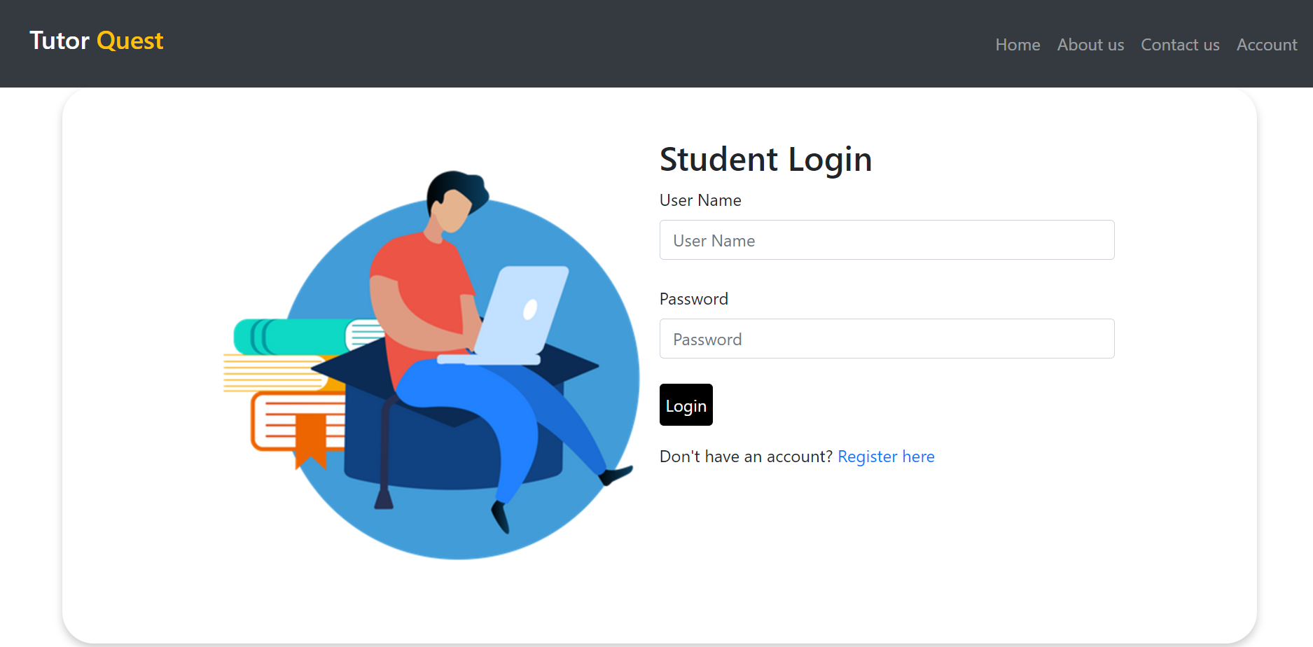

Slide 11
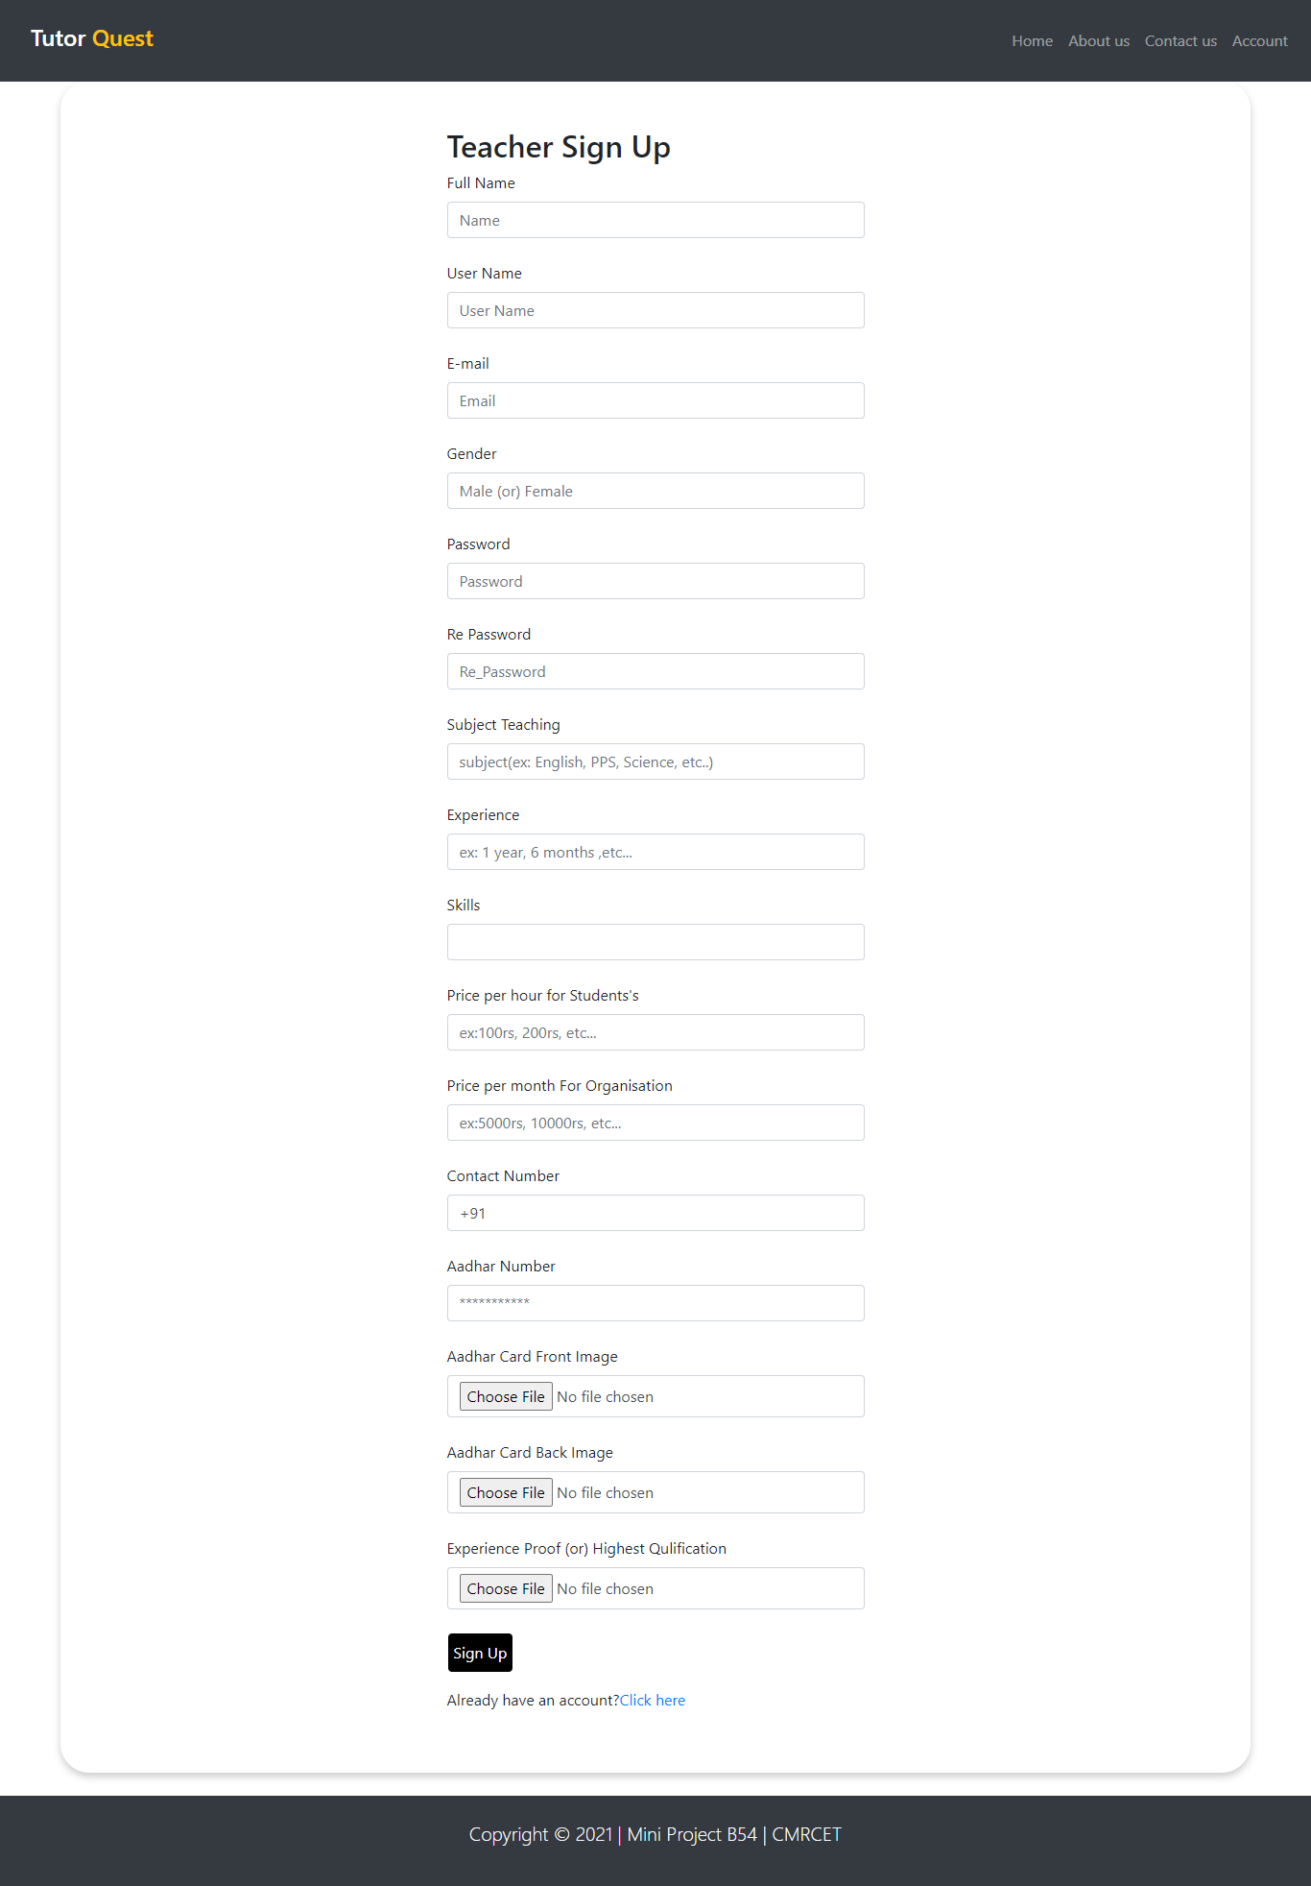
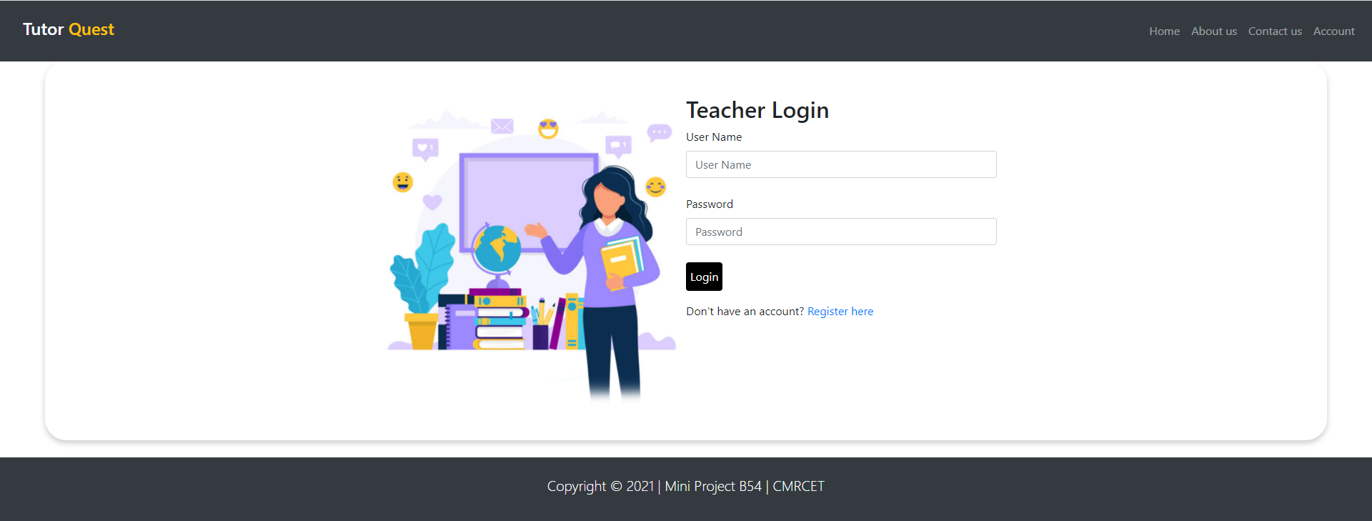

Slide 12
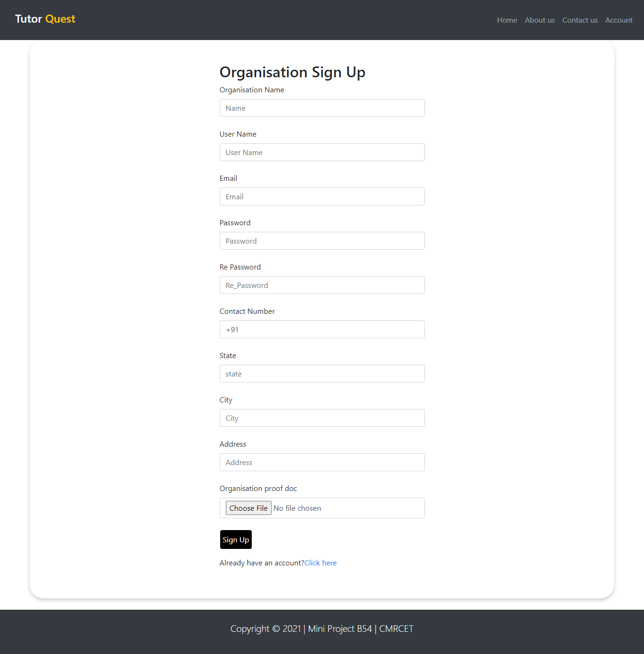
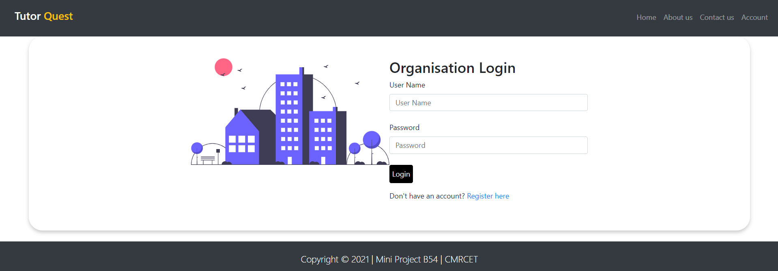

Slide 13
ADVANTAGES
Students and organizations can find tutors easily on our platform based on their requirements.
Proper verification of each user is done to ensure safety and security.
Low Charges: Since we do not take any commission from monthly tuition fee.

Slide 14
APPLICATONS:
Organizations can look for recruiting teachers from our web application.
Anyone who has talent and passion to teach and share their knowledge can register themselves on our application.
Students can take 1:1 classes with less amount charged by the tutors since we do not take any commission from monthly tuition fee.

Slide 15

FUTURE SCOPE
Try automating the verification process.
Integrating the application with it’s own video conferencing software.
Developing it further to make it scalable and reliable.

Slide 16
CONCLUSION
A platform for students who are passionate to learn new things, teachers who want to make future better by sharing their knowledge as well as making their ends meet and organization for recruiting teachers is made.

